Slide 1
Network design proposal for small office

Slide 2
Team Members:
RA2011003010948-KARTIK AGAL
RA2011003010936-RHYTHM PAHWA
RA2011003010910-ANUJ
RA2011003010932-HARSHIT SINGH
RA2011003010914-YASH

Slide 3
Abstract
The paper outlined the steps involved in structure network design and deployment for a small office need. It presented the steps (or phases) of a structured network design and demonstrated a practical implementation of the steps using a real life case study. The design was first simulated using Cisco Packet Tracer™ software and with the help of RIP V2 protocol and VLAN . Specifically, the paper demonstrated first hand, how a small network may be set up using the five phases beginning with the needs analysis.
The project is focused on WLANs and associated wireless technology. Hence, further to wireless technology, the guide also delves into security issues. The network and devices provided by the management have firewall and security software installed in it. The hardware and tools used for the project are Router, Switch, Desktop,Wireless Router, Ethernet cable, Cisco Packet Tracer to create a prototype for the proposal.

Slide 4
Introduction
Background of the project
Creating a small office network using RIP v2 protocol and Vlan
A network proposal has to be designed for a small office
ADSL internet connection
All users should have secure wireless access to the network, with the flexibility to connect via LAN.
A file server for sharing files on the network.
Hosted Email servers for email access.
Administrator should be able to remotely view and control the file server from any location on the internet.

Slide 5
Aim: Network design proposal for small office
DESCRIPTION
Extensive planning should go into a network installation/implementation. Just like any project, a need is identified and then a plan outlines the process from beginning to end. The plan should clearly define the tasks, and the order in which tasks are completed. The main goal of our project is to more accurately represent users’ needs, which unfortunately often are ignored or misrepresented. Another goal is to make the project manageable by dividing it into modules that can be more easily maintained and changed.
This project will result in understanding how an organization operates its network architecture, how it administers and maintains the security of the network and what are the challenges faced while architecting the network. A prototype was built which simulates the build and function of the network using virtual tools.

Slide 6
Literature survey
ROUTERS
The concept of an Interface computer was first proposed by Donald Davies for the NPL network in 1966. The same idea was conceived by Wesley Clark the following year for use in the ARPANET. Named Interface Message Processors (IMPs), these computers had fundamentally the same functionality as a router does today. The idea for a router (called gateways at the time) initially came about through an international group of computer networking researchers called the International Networking Working Group (INWG). Set up in 1972 as an informal group to consider the technical issues involved in connecting different networks, it became a subcommittee of the International Federation for Information Processing later that year. These gateway devices were different from most previous packet switching schemes in two ways. First, they connected dissimilar kinds of networks, such as serial lines and local area networks. Second, they were connectionless devices, which had no role in assuring that traffic was delivered reliably, leaving that entirely to the hosts. This particular idea, the end-to-end principle, had been previously pioneered in the CYCLADES network.
SWITCH
A network switch is a multiport network bridge that uses MAC addresses to forward data at the data link layer (layer 2) of the OSI model. Some switches can also forward data at the network layer (layer 3) by additionally incorporating routing functionality. Such switches are commonly known as layer-3 switches or multilayer switches.

Slide 7
Ethernet
Ethernet was developed at Xerox PARC between 1973 and 1974. It was inspired by ALOHAnet, which Robert Metcalfe had studied as part of his PhD dissertation. The idea was first documented in a memo that Metcalfe wrote on May 22, 1973, where he named it after the luminiferous aether once postulated to exist as an "omnipresent, completely-passive medium for the propagation of electromagnetic waves." In 1975, Xerox filed a patent application listing Metcalfe, David Boggs, Chuck Thacker, and Butler Lampson as inventors. In 1976, after the system was deployed at PARC, Metcalfe and Boggs published a seminal paper. Yogen Dalal, Ron Crane, Bob Garner, and Roy Ogus facilitated the upgrade from the original 2.94 Mbit/s protocol to the 10 Mbit/s protocol, which was released to the market in 1980.
ADSL
ADSL was specifically designed to exploit the one-way nature of most multimedia communication in which large amounts of information flow toward the user and only a small amount of interactive control information is returned. Several experiments with ADSL to real users began in 1996. In 1998, wide-scale installations began in several parts of the U.S. In 2000 and beyond, ADSL and other forms of DSL are expected to become generally available in urban areas. With ADSL (and other forms of DSL), telephone companies are competing with cable companies and their cable modem services.

Slide 8
Architecture/Design with Modules Description

Slide 9
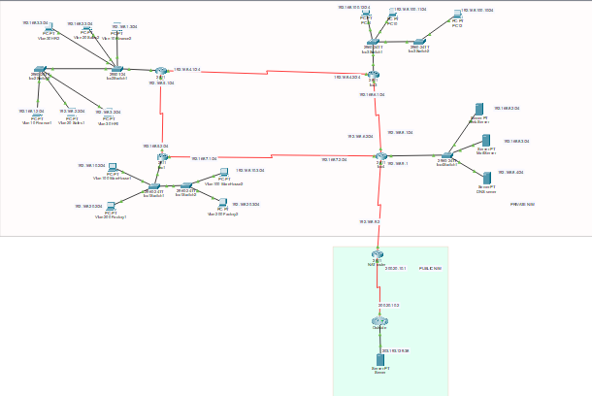

Slide 10
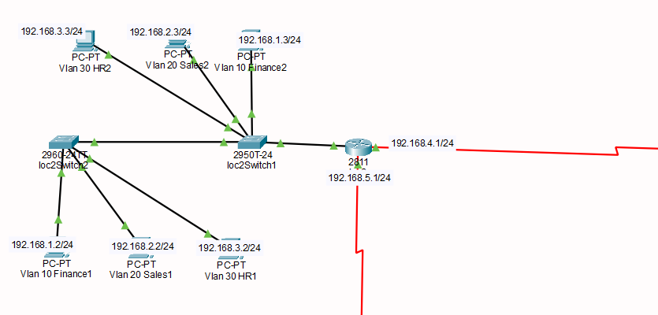
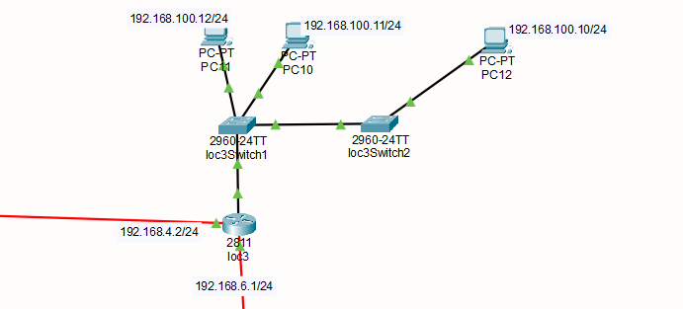
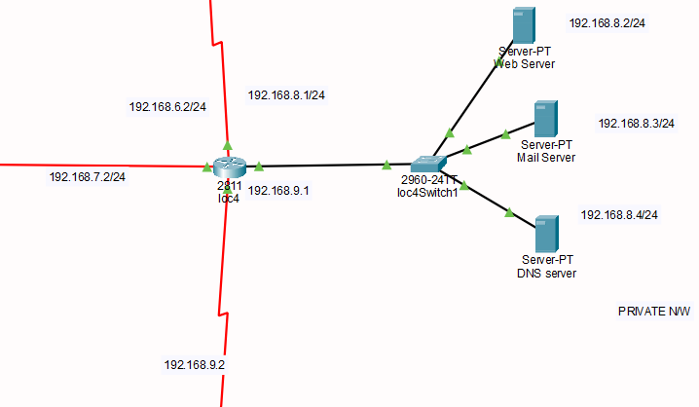
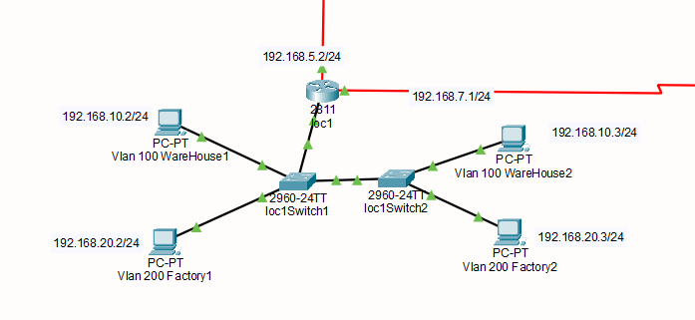

Slide 11
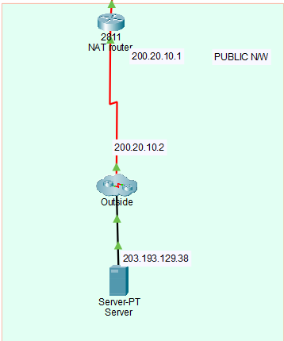
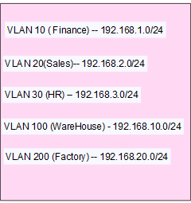
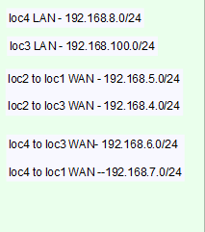
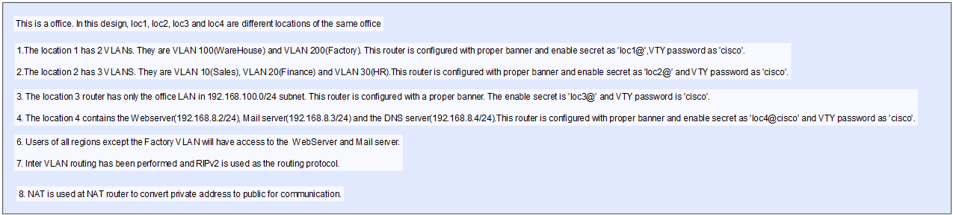

Slide 12
Calculations and Implementation
In the above design all we have 5 routers in which RIP V2 routing is done and several devices are connected through Vlan .6 switches are there provided with their subnet addresses and though each subnet several devices are connected though Vlan configuration of which each are assigned with a particular office.
VLAN 10 ( Finance) -- 192.168.1.0/24
VLAN 20(Sales)-- 192.168.2.0/24
VLAN 30 (HR) -- 192.168.3.0/24
VLAN 100 (WareHouse) - 192.168.10.0/24
VLAN 200 (Factory) -- 192.168.20.0/24

Slide 13
loc4 LAN - 192.168.8.0/24
loc3 LAN - 192.168.100.0/24
loc2 to loc1 WAN - 192.168.5.0/24
loc2 to loc3 WAN - 192.168.4.0/24
loc4 to loc3 WAN- 192.168.6.0/24 loc4 to loc1 WAN --192.168.7.0/24
This is a office. In this design, loc1, loc2, loc3 and loc4 are different locations of the same office

Slide 14
1.The location 1 has 2 VLANs. They are VLAN 100(WareHouse) and VLAN 200(Factory). This router is configured with proper banner and enable secret as 'loc1@',VTY password as 'cisco'.
2.The location 2 has 3 VLANS. They are VLAN 10(Sales), VLAN 20(Finance) and VLAN 30(HR).This router is configured with proper banner and enable secret as 'loc2@' and VTY password as 'cisco’.
3. The location 3 router has only the office LAN in 192.168.100.0/24 subnet. This router is configured with a proper banner. The enable secret is 'loc3@' and VTY password is 'cisco'.
4. The location 4 contains the Webserver(192.168.8.2/24), Mail server(192.168.8.3/24) and the DNS server(192.168.8.4/24).This router is configured with proper banner and enable secret as 'loc4@cisco' and VTY password as 'cisco’.
5. Users of all regions except the Factory VLAN will have access to the Web Server and Mail server.
6. Inter VLAN routing has been performed and RIPv2 is used as the routing protocol.
7. NAT is used at NAT router to convert private address to public for communication.

Slide 15
Results and Discussion

Slide 16
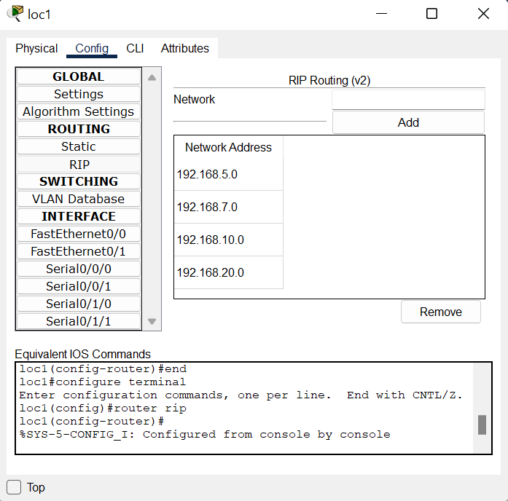
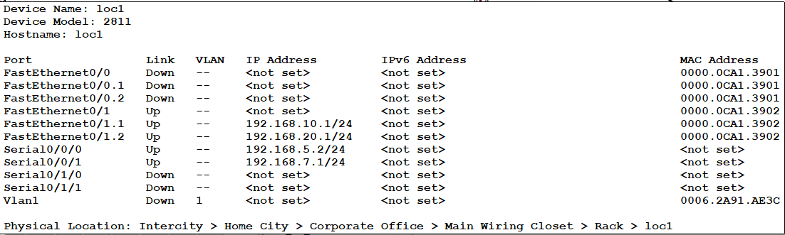
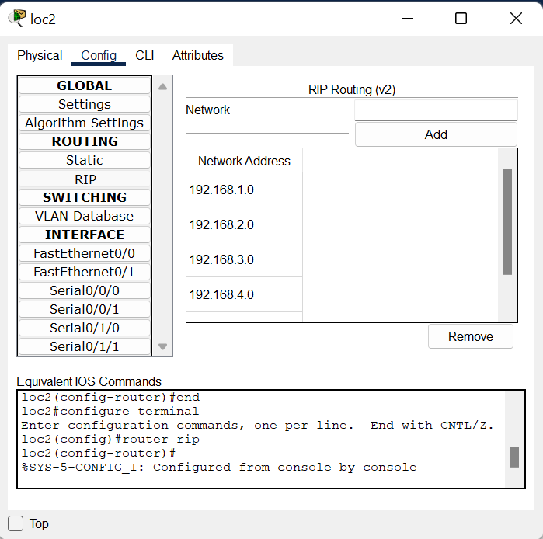
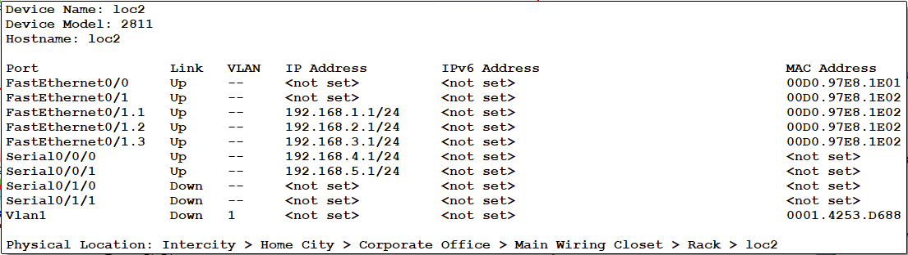

Slide 17
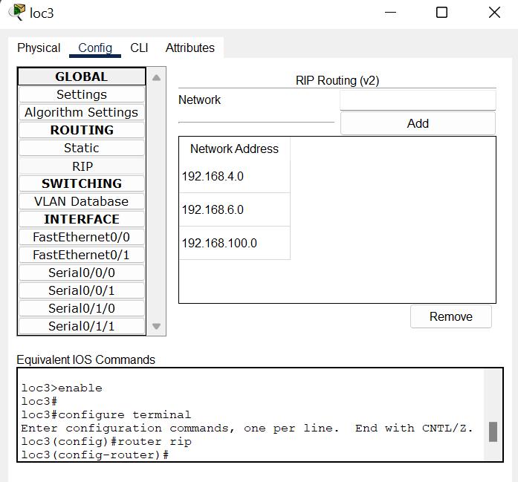
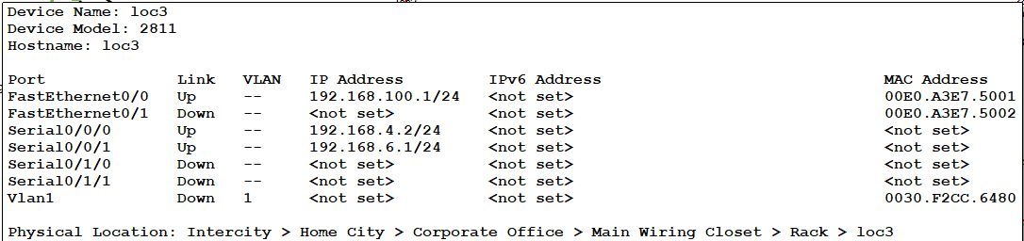
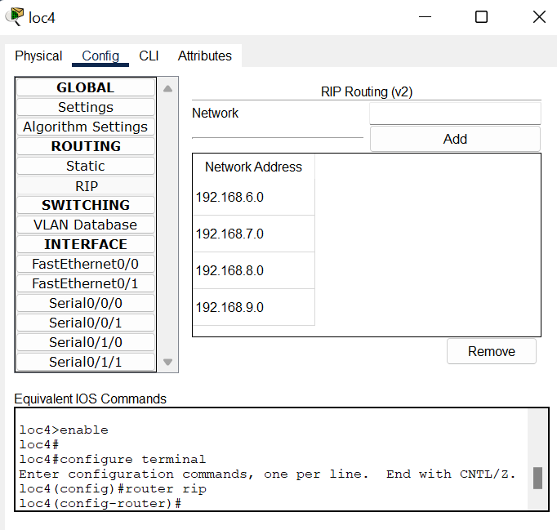
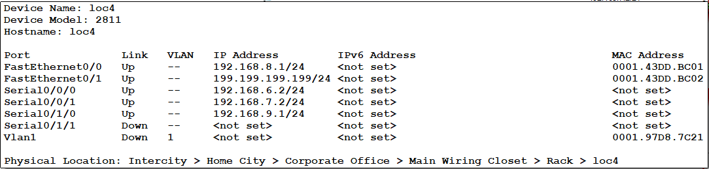

Slide 18
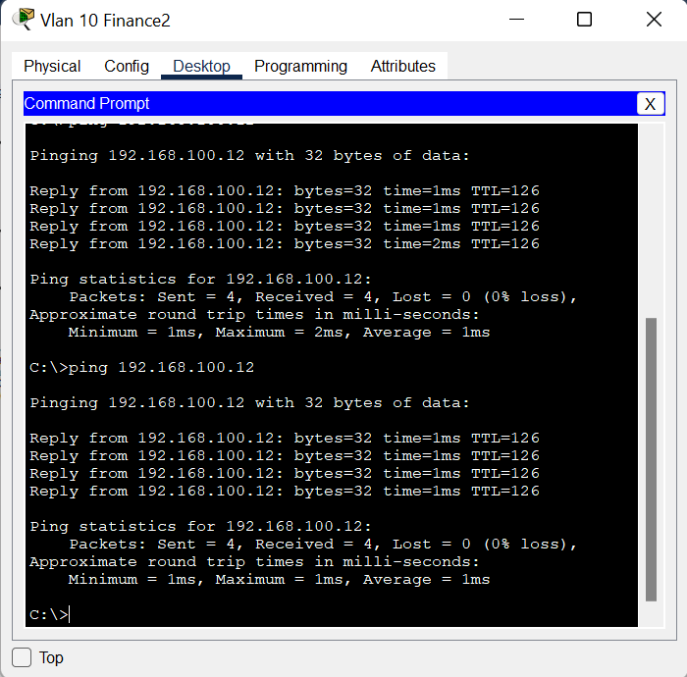
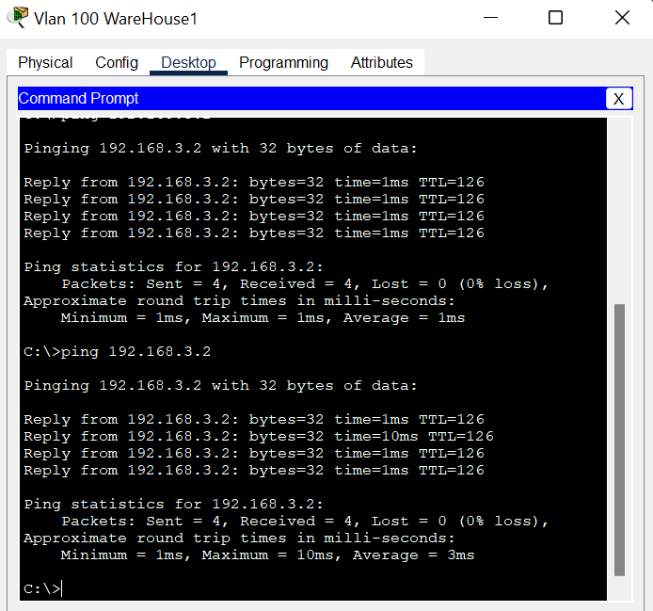

Slide 19
Conclusion
Our project outlined the steps involved in structure network design and deployment for a small office home office need. It presented the steps (or phases) of a structured network design and demonstrated a practical implementation. The design was first simulated using Cisco Packet Tracer™. By doing this project we learnt how to apply this knowledge in real life , and It also benefitted as we can pursue in this field in future .The design of small office is fully working and functional.

Slide 20
References
[1] Priscilla Oppenheimer, (2010). “Top-Down Network Design”, 3rd ed. Cisco Press, Indianapolis, USA *
[2]+ Meraki Inc. (2011). “Network Design Guide” *online+ Available at http://meraki.cisco.com/lib/pdf/ meraki_setup_network_design.pdf
[3] Cisco Packet Tracer Brochure, http://www.cisco.com/web/learning/neta cad/downloads/pdf/ PacketTracer5_0_DS_0703.pdf
[4] Wikipedia, http://en.wikipedia.org/wiki/Bandwidth_(c omputing) [5] WireShark. www.wireshark .org/about.html.
[6] Wikipedia, http://en.wikipedia.org/wiki/WiFi_Protected_Access

